Slide 1
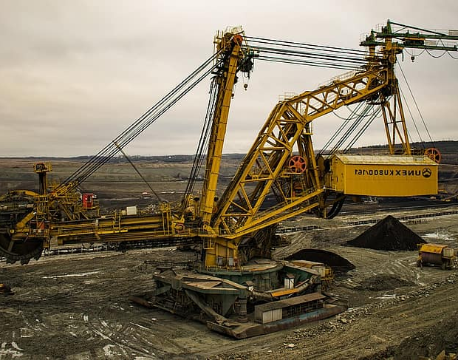
Mine
Now
Future of Mineral Exploration through Machine Learning

Slide 2


Mining & Australia
The period of Gold Rush
77 B$ or 5.6 % of Australia’s GDP
1800’s
1850’s
1960’s
2019
Discovery of the first Coal Mine
Resource boom and international recognition

Slide 3
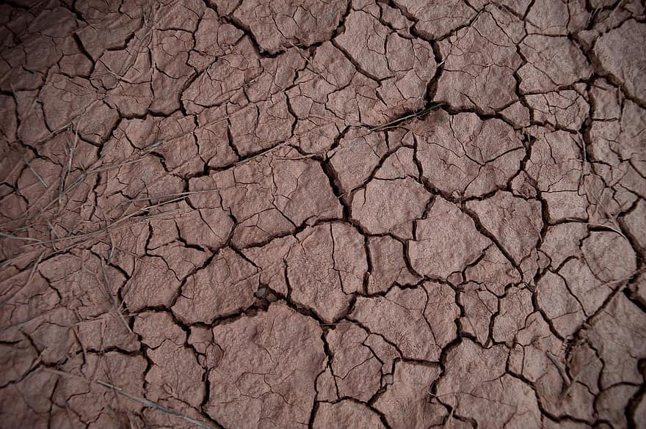
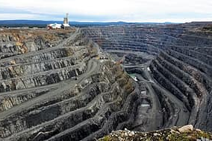
The Need for New Mineral Exploration Methods -
Already Discovered
Drying Out
Most outcropping deposits have already been discovered.
Mature Mining Camps are starting to dry out.

Slide 4
What If?
I could tell you more around 340,000 Novel Mineralization

Slide 5
I’m telling the truth!

Slide 6
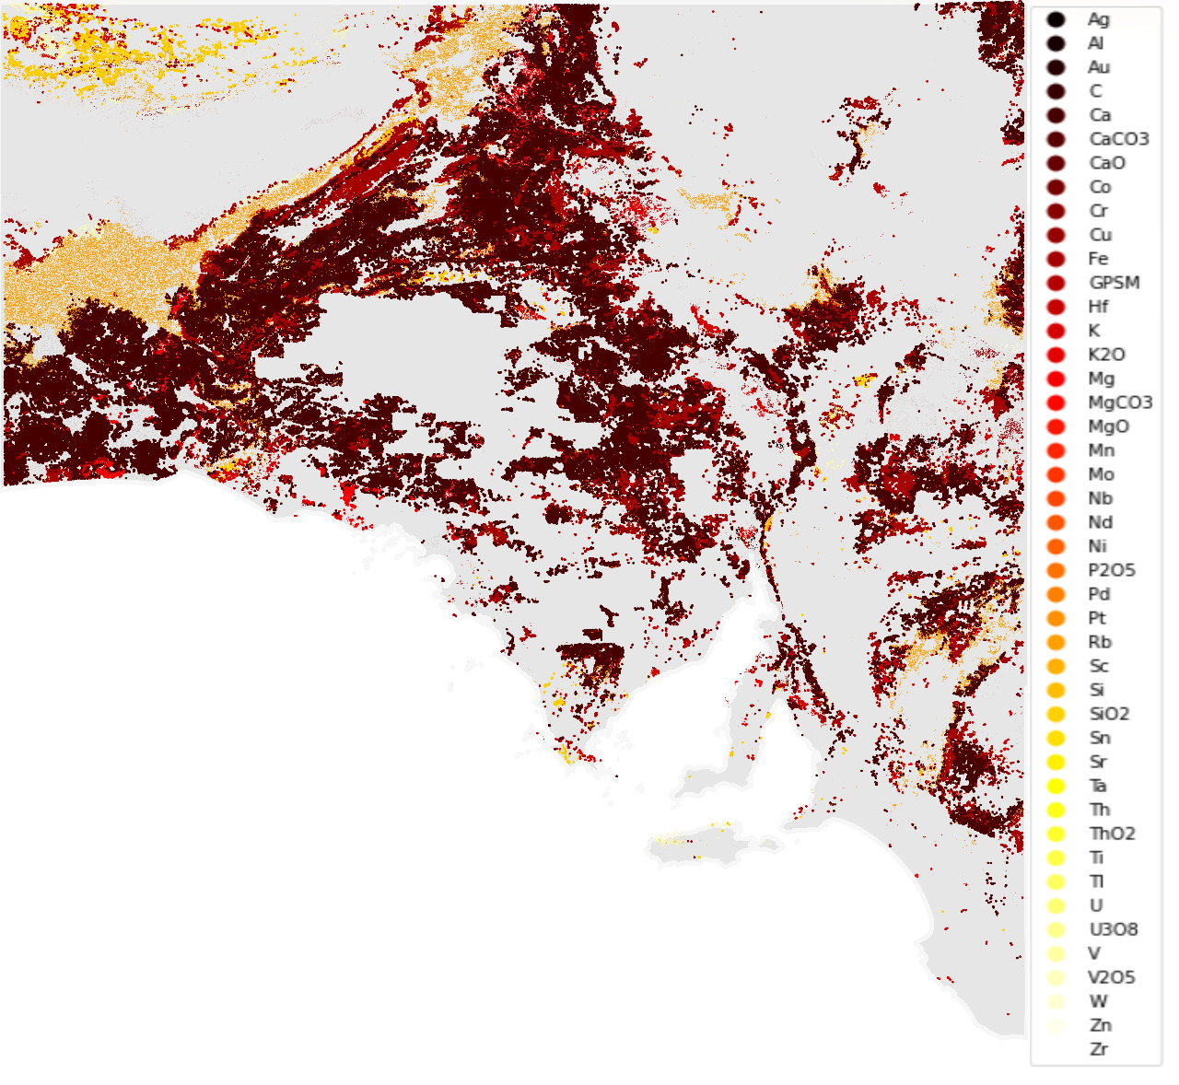
341,802
200 Billion $ +
41 Minerals
New Mineralized Points
Worth of Minerals
Including Precious minerals such as Au, Ti, V, Tl, & U308

Slide 7
Let’s See the Magic!

Slide 8
What features can determine mineralization?
2. Can we learn those features using the existing data?

Slide 9
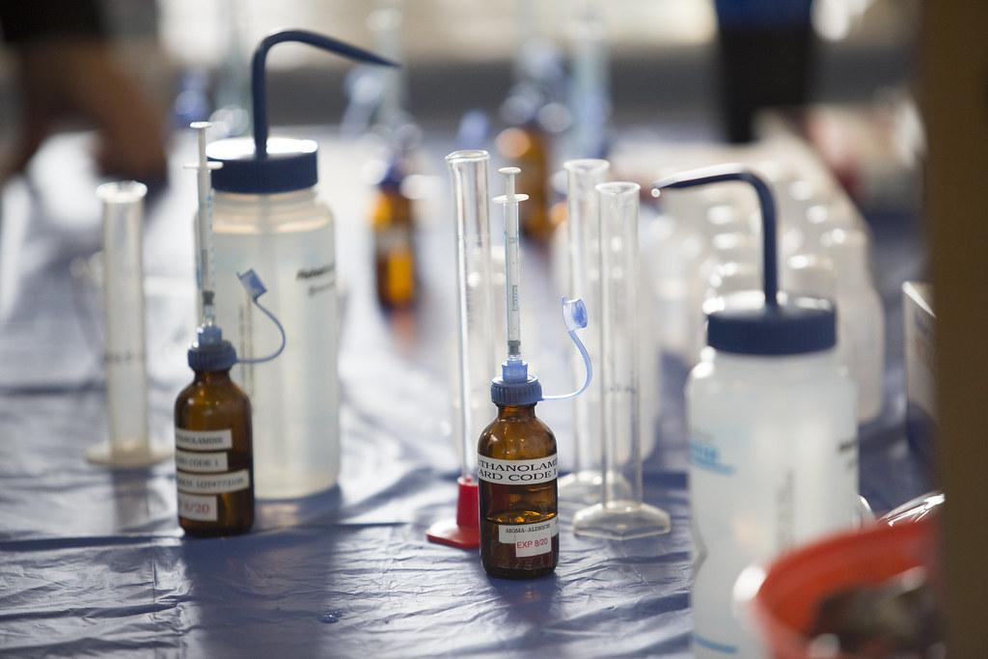
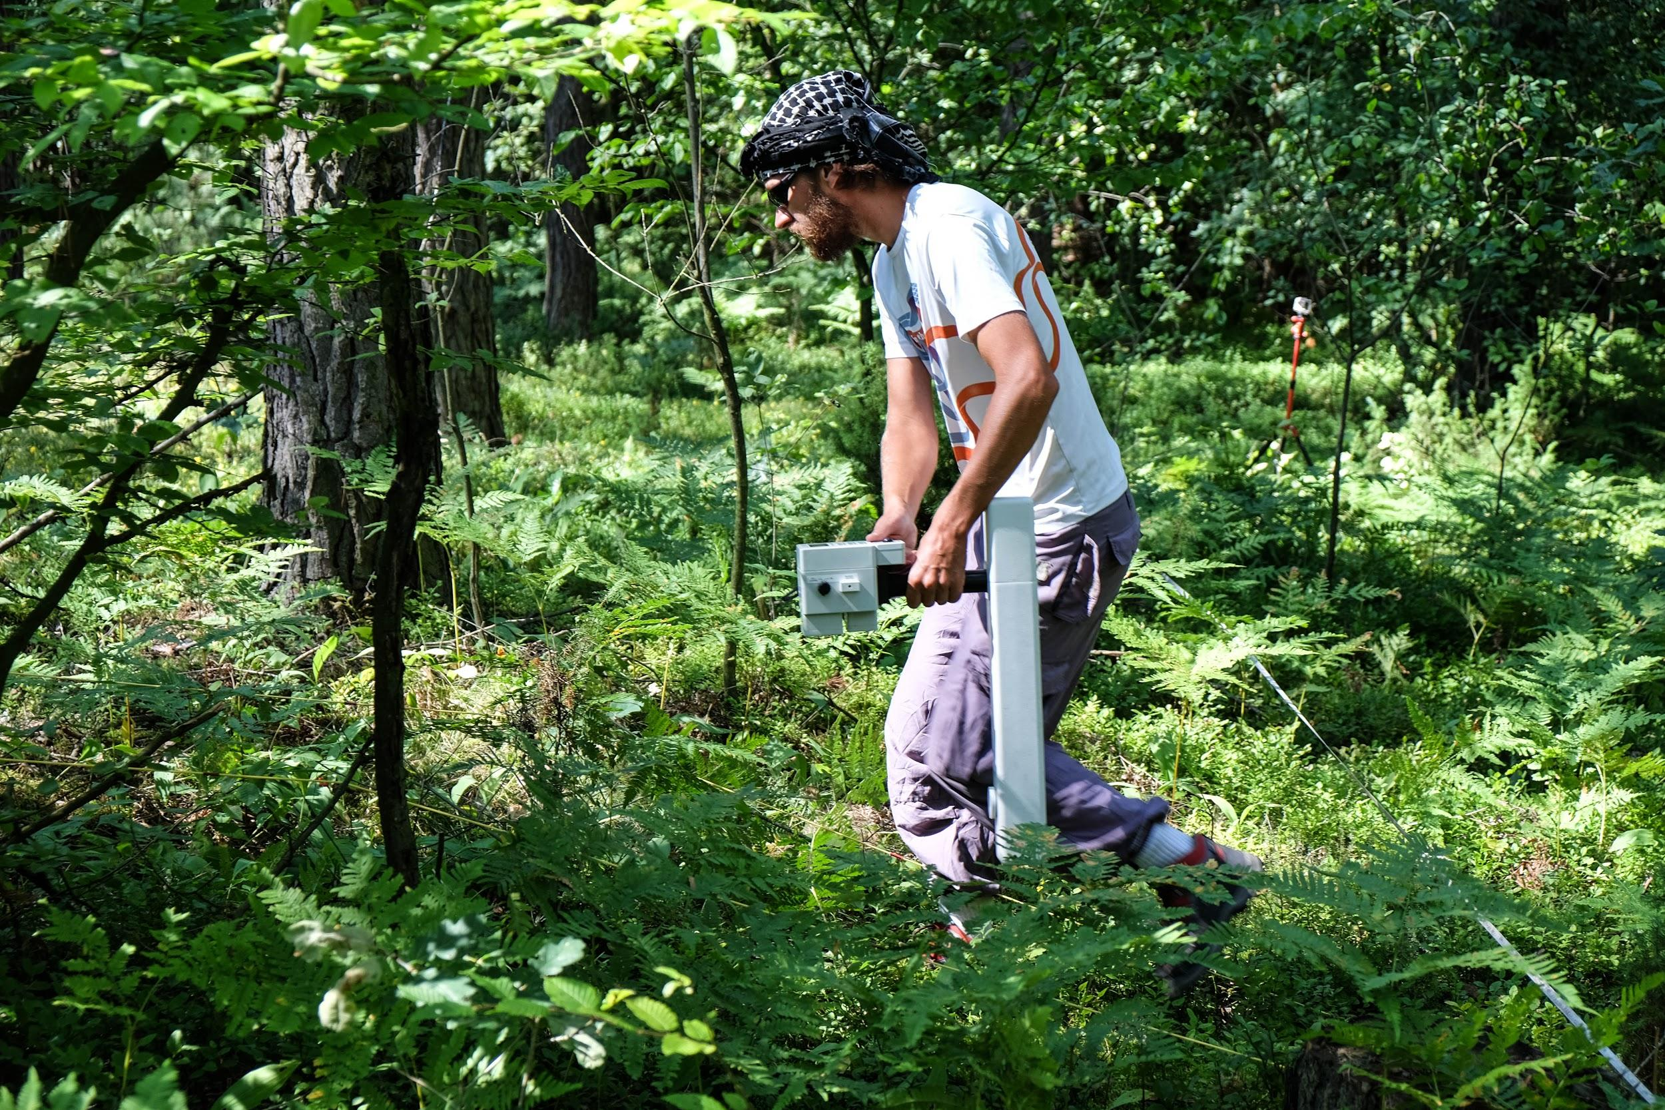
Two Categories of Data
GeoPhysical
Geochemical
Eg. Gravity, Magnetics, etc. of the whole landmass of Gawler province in the form of rasters.
Comprising of details such as Depth, Mineral Classes, etc. of the already existing mineral locations.

Slide 10
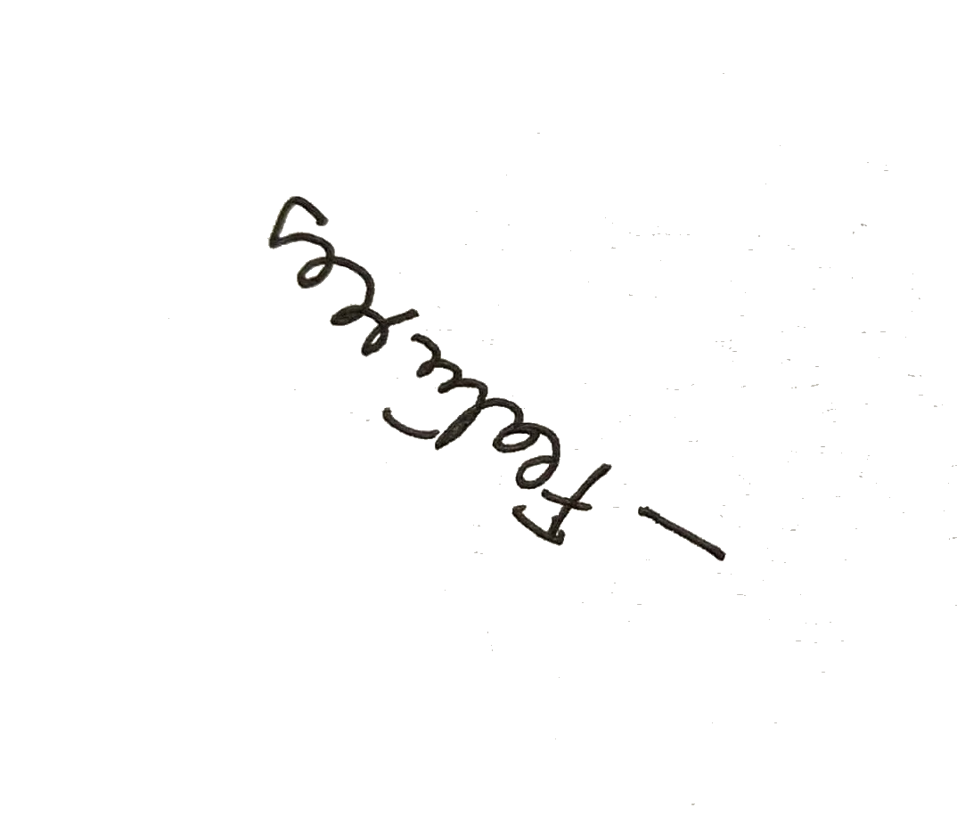
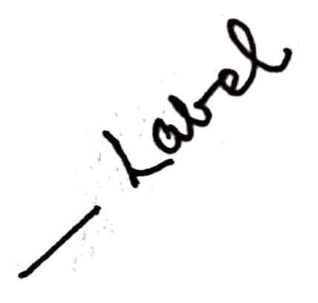
Two Categories of Data
GeoPhysical
Geochemical
Eg. Gravity, Magnetics, etc. of the whole landmass of Gawler province in the form of rasters.
Comprising of details such as Depth, Mineral Classes, etc. of the already existing mineral locations.

Slide 11
You Could Use Three Columns, Why Not?
Mars
Jupiter
Saturn
Mars is a cold place. It’s full of iron oxide dust, which gives the planet its reddish cast
It’s the biggest planet in the Solar System. It was named after a Roman god
Yes, this is the ringed one. It’s a gas giant, composed mostly of hydrogen and helium

Slide 12
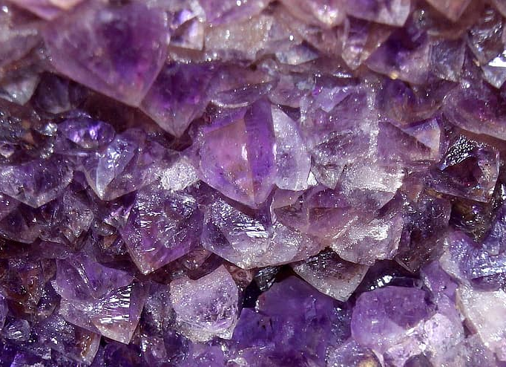
01
‘Wh're Art Thee Min'ral?’
Binary Classifier which predicts mineralization given the geophysical features of a location

Slide 13
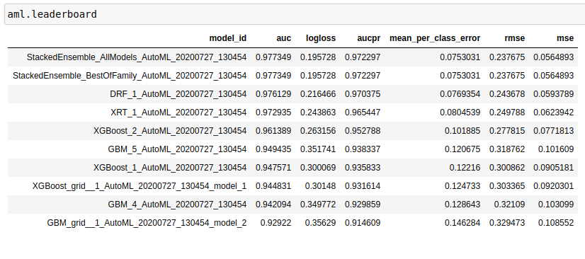
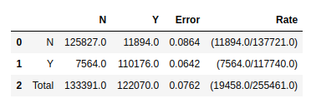

Slide 14
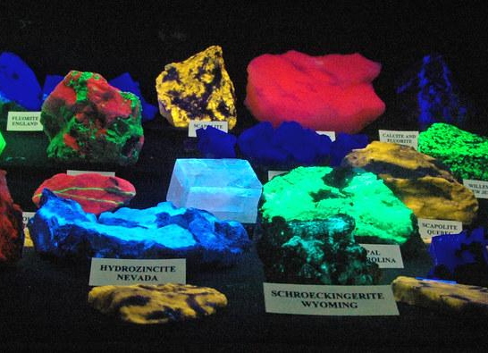
02
‘Bid Me Thy Nameth!’
Multiclass classifier that predicts which mineral would most dominantly be found

Slide 15
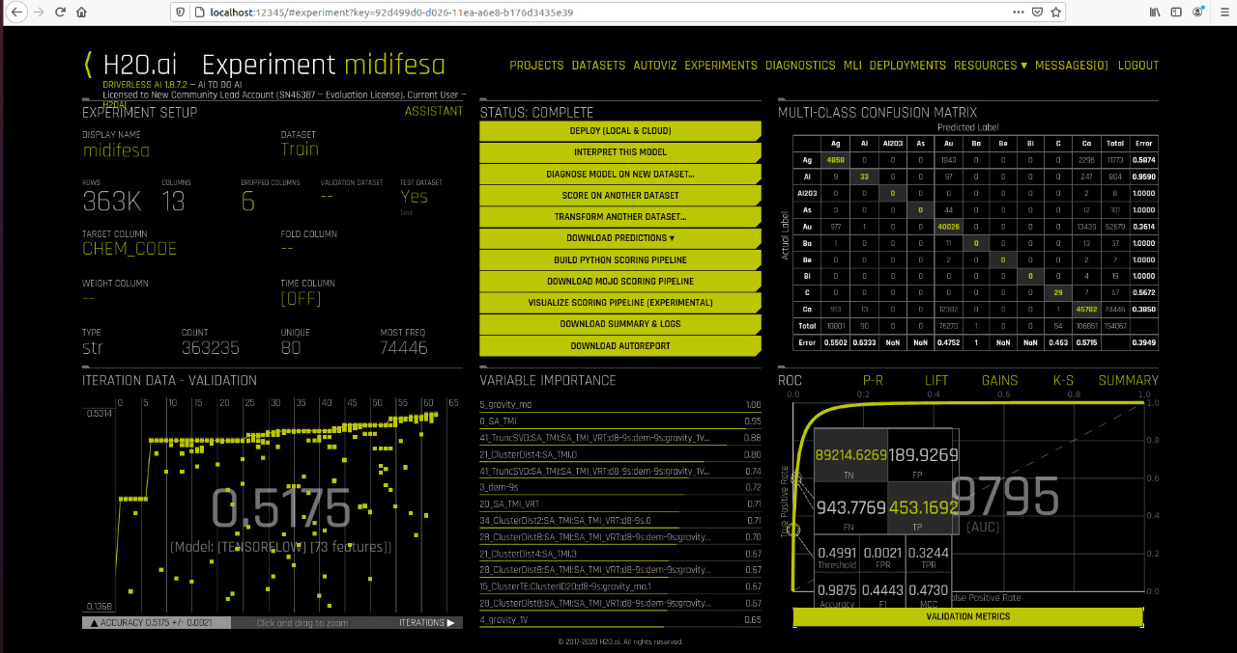

Slide 16
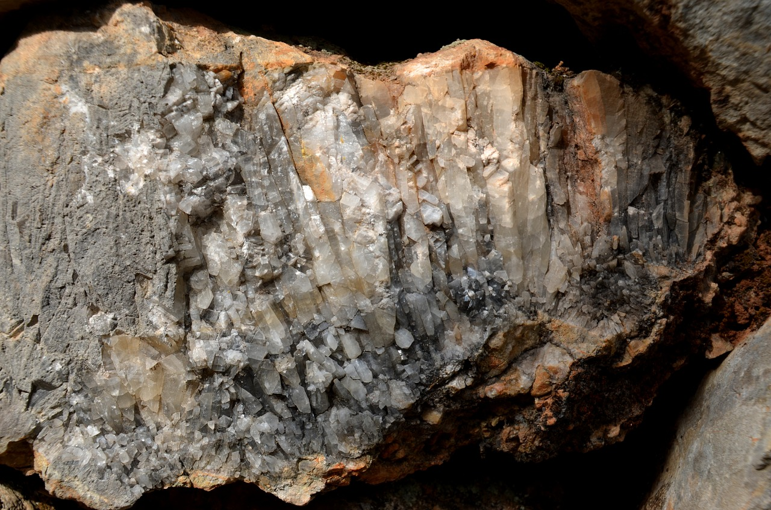
03
‘How Big Art Thee’
Multiclass Classifier that predicts the type of size of the deposit.

Slide 17
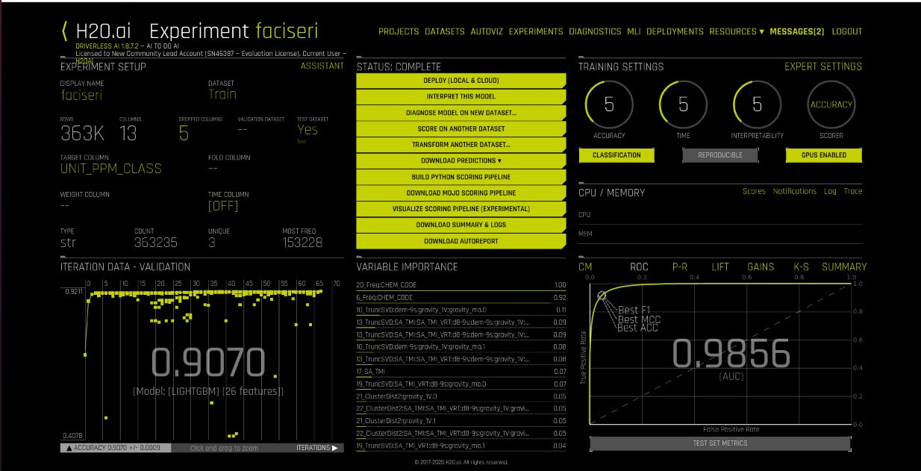

Slide 18
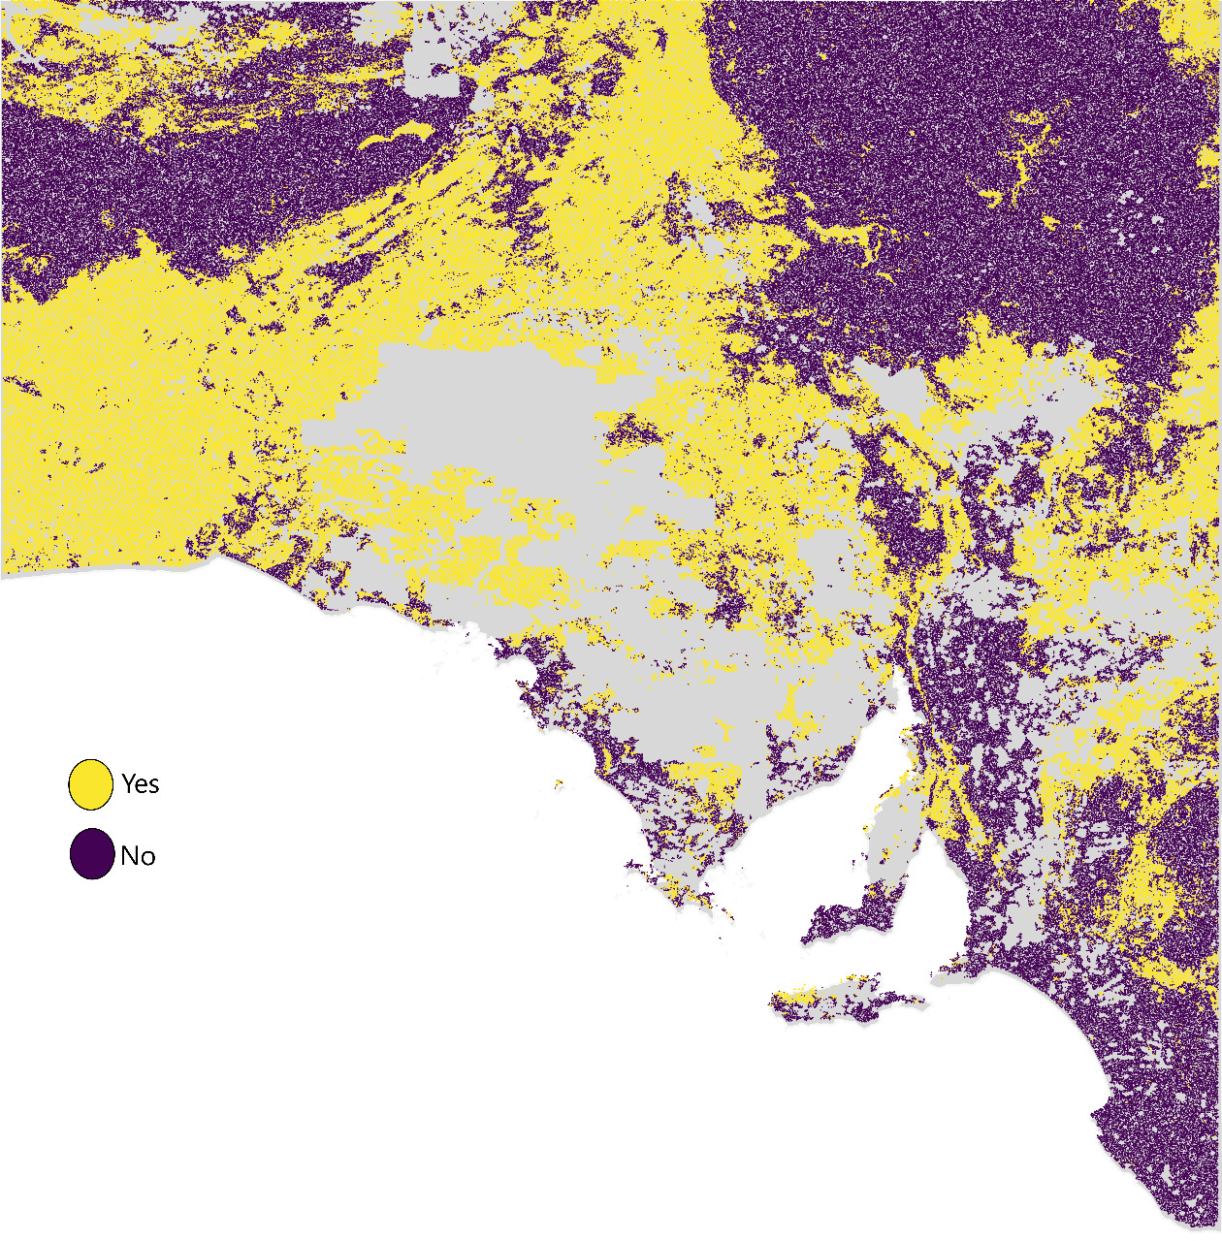
325,000
Total Mineralized Points

Slide 19
Generation of Novel Mineralized Locations
>
>
>
Generation
Sampling
Predictions
Analysis
of novel points excluding the already dug locations
Of geophysical features of the generated points
By the trained models on the sampled data
Analysing and visualising models’ predictions

Slide 20
— Mine Now
“This solution might just be the beginning, but it will set the pavement for the future of Mineral Exploration through Machine Learning”

